Slide 1
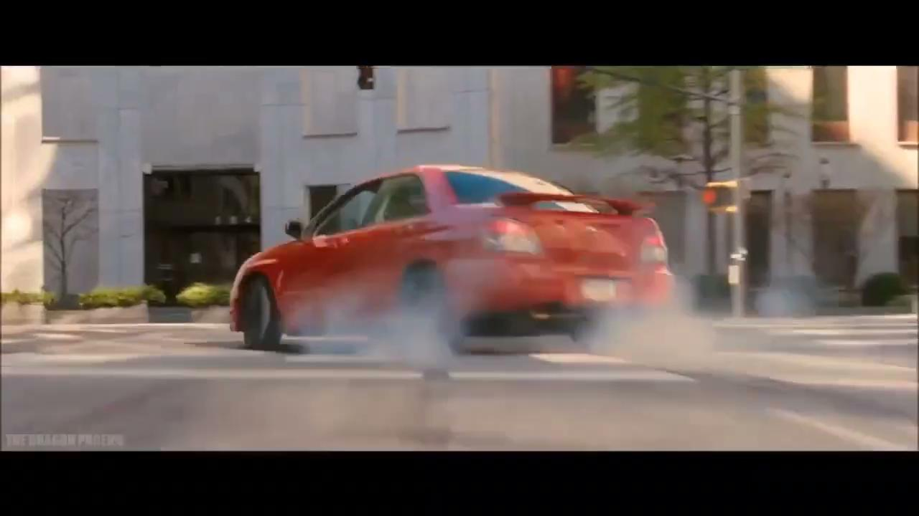

Slide 2
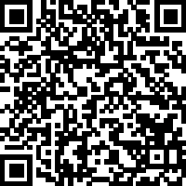
Serving in Love
Sermon Notes:
John 13:34-35
His Way Baptist Church
Keith Desso Douglas, Executive Pastor - Derrick Keith Douglas, Pastor
1818 Esther St. Houston, Tx 77088

Slide 3
Serving in Love
1. Understanding Jesus’ Command to Love One Another
“A new command I give you: Love one another. As I have loved you, so you must love one another. By this everyone will know that you are my disciples, if you love one another.”
Jesus ________ us to love one another as He ________ us (John 13:34-35).
commands
loved
This love is a mark of being His _______.
disciples
How am I _________ love in my relationships?
showing

Slide 4
Serving in Love
2. Following Christ’s Example of Humble Service
John 13:12-15 - “When he had finished washing their feet, he put on his clothes and returned to his place. ‘Do you understand what I have done for you?’ he asked them. ‘You call me ‘Teacher’ and ‘Lord,’ and rightly so, for that is what I am. Now that I, your Lord and Teacher, have washed your feet, you also should wash one another’s feet. I have set you an example that you should do as I have done for you.’”
feet
Jesus washed His disciples’ _____ as an example of humility (John 13:12-15).
service
True love is shown through acts of _________ , not just words.
scenes
A leader who serves behind the ________ , modeling humility.
kindness
Identify small acts of ________ you can do this week.

Slide 5
Serving in Love
The Science of Kindness

Slide 6
Serving in Love
3. Using Our Gifts to Serve Others
1 Peter 4:10 - “Each of you should use whatever gift you have received to serve others, as faithful stewards of God’s grace in its various forms.”
gifts
Each of us has been given unique ________ to serve others (1 Peter 4:10).
grace
These gifts are a reflection of God’s ________.
bless
Am I using my gifts to ________ the body of Christ?
Someone with the gift of __________ creating a welcoming environment.
hospitality

Slide 7
Serving in Love
4. Serving with the Right Heart
Colossians 3:23 - “Whatever you do, work at it with all your heart, as working for the Lord, not for human masters.”
heart
Lord
Whatever you do, work at it with all your ________ , as working for the ________ (Colossians 3:23).
True service is done for God’s _____ , not for recognition.
glory
A volunteer who serves faithfully without seeking _____ .
praise
motives
Reflect on your ___________ for serving. Ask, “Am I doing this to honor God?”

Slide 8
Serving in Love
Matthew 6:33
Weekly Challenge
Jesus calls us to love through service, to serve humbly, use our gifts, and serve with pure motives.
Challenge: Serve at least one person daily this week in an intentional act of love, whether small or large.

