Slide 2
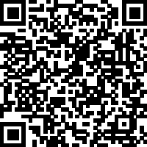
The Stewardship of Self
1 Corinthians 6:19-20 - "Do you not know that your bodies are temples of the Holy Spirit, who is in you, whom you have received from God? You are not your own; you were bought at a price. Therefore, honor God with your bodies."
Sermon Notes:
His Way Baptist Church
Keith Desso Douglas, Executive Pastor - Derrick Keith Douglas, Pastor
1818 Esther St. Houston, TX 77088

Slide 3
The Stewardship of Self
1 Corinthians 6:19-20
Self-Care as Stewardship
body
mind
spirit
God has entrusted us with our ______, ______, and ______.
image
Genesis 1:26 – We are created in God’s ________ and given responsibility over His creation.
Stewardship means taking ______________, not neglecting or abusing what God has given.
responsibility

Slide 4
The Stewardship of Self
1 Corinthians 6:19-20
2. The Connection Between Body, Mind, and Spirit
guard
heart
Proverbs 4:23 – "Above all else, ________ your _______, for everything you do flows from it."
mind
What affects the body impacts the _______, and what affects the mind impacts the ________.
spirit
heart
Mark 12:30 – We are called to love the Lord with all our ______, ______, ______, and __________.
soul
mind
strength

Slide 5
The Stewardship of Self
1 Corinthians 6:19-20
3. Breaking the Burnout Cycle
quiet
Mark 6:31 – "Come with me by yourselves to a ______ place and get some ______."
rest
withdraw
rest
Even Jesus took time to __________, ______, and be alone with God.
badge
Burnout is not a _________ of honor; it is a sign that we are ___________ more than we were meant to.
carrying

Slide 6
The Stewardship of Self
1 Corinthians 6:19-20
Weekly Challenge
Reflect – Where have you neglected self-care?
Act – Make one intentional change this week to care for yourself better.
Pray – Ask God for wisdom to steward your body, mind, and spirit well.

Slide 7
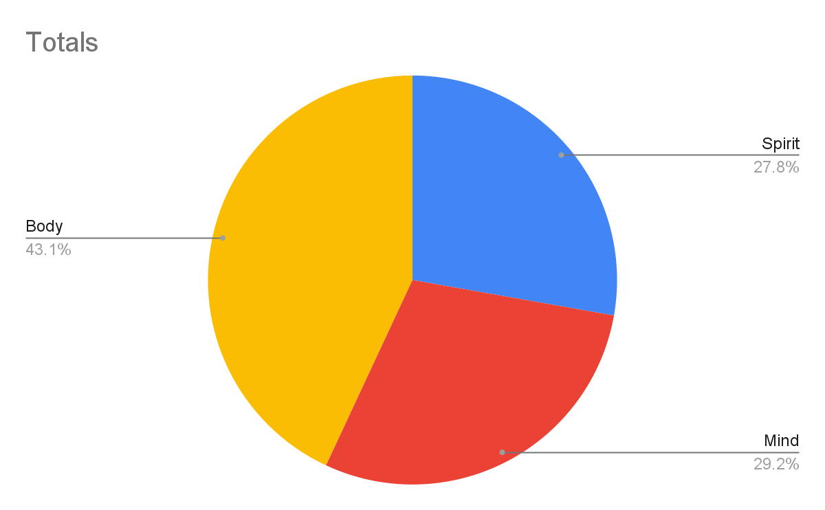
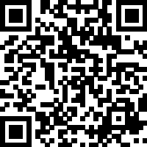
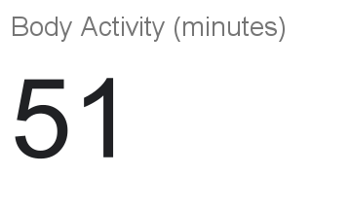
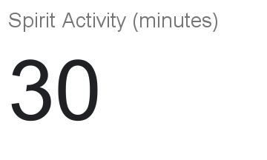
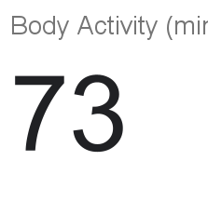
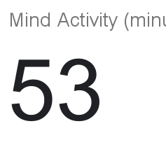
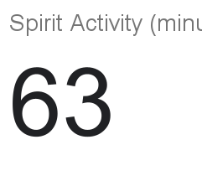
Self-Care Tracker

