Slide 2
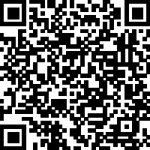
Renewing Your Mind
Romans 12:2 - "Do not conform to the pattern of this world, but be transformed by the renewing of your mind. Then you will be able to test and approve what God’s will is—his good, pleasing and perfect will."
Sermon Notes:
His Way Baptist Church
Keith Desso Douglas, Executive Pastor - Derrick Keith Douglas, Pastor
1818 Esther St. Houston, TX 77088

Slide 3
Renewing Your Mind
Romans 12:2
Guarding Your Thoughts
true
noble
Philippians 4:8 – "Finally, brothers and sisters, whatever is _________, whatever is __________, whatever is __________, whatever is __________, whatever is __________, whatever is _________________ —if anything is excellent or praiseworthy—think about such things."
right
pure
lovely
admirable
minds
What we allow into our ______ shapes our emotions, decisions, and faith.
Our mental health starts with intentional _________ and what we allow to influence us.
thinking

Slide 4
Renewing Your Mind
Romans 12:2
2. Filtering What We Consume
company
1 Corinthians 15:33 – "Do not be misled: 'Bad ____________ corrupts good ___________.'"
character
media
news
entertainment
Social ___________, __________, ________________, and even certain relationships can impact our mental well-being.
Transformation requires a renewed ______ (Romans 12:2).
mind

Slide 5
Renewing Your Mind
Romans 12:2
3. Practicing Gratitude and Worship
pray
thanks
1 Thessalonians 5:16-18 – "Rejoice always, _______ continually, give _________ in all circumstances; for this is God’s will for you in Christ Jesus."
stress
God’s
Gratitude shifts our focus from ______ to ______ faithfulness .
Worship is a powerful _______ to re-center our _______ on God’s truth.
tool
minds

Slide 6
Renewing Your Mind
Romans 12:2
Weekly Challenge
Reflect – What influences are shaping your thoughts?
Act – Make one intentional change this week to guard your mind.
Pray – Ask God to help you filter what you consume and fill your thoughts with His truth.

Slide 7
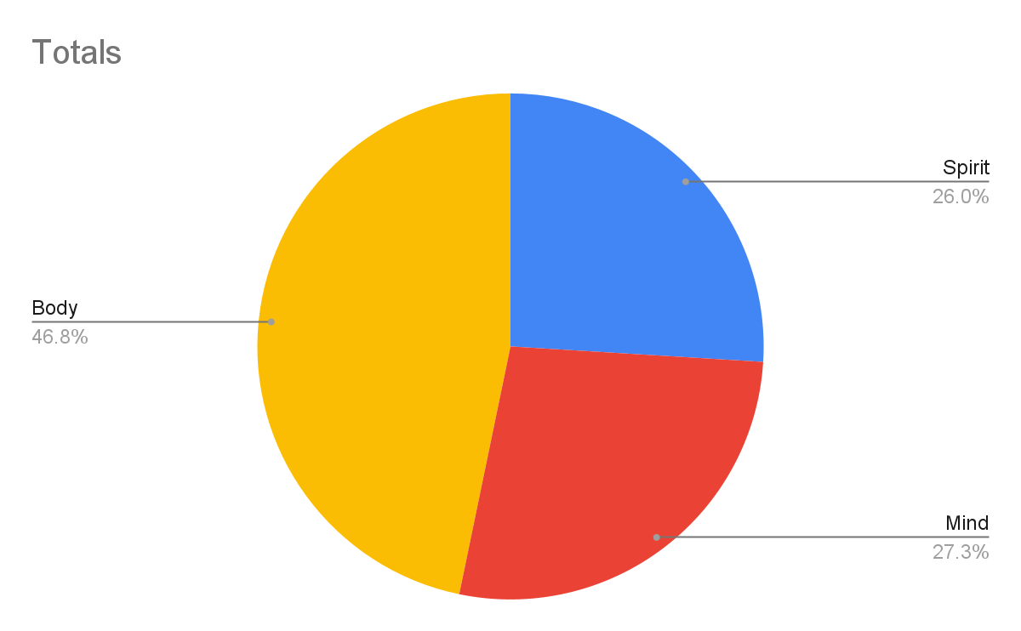
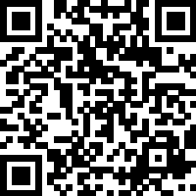
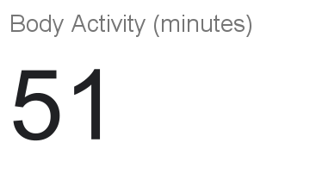
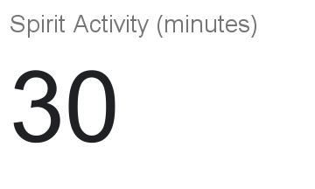
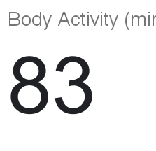
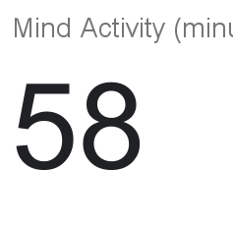
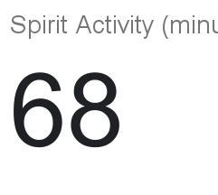
Self-Care Tracker

