Slide 2
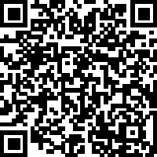
Caring for Your Body
1 Corinthians 10:31 - "So whether you eat or drink or whatever you do, do it all for the glory of God."
Sermon Notes:
His Way Baptist Church
Keith Desso Douglas, Executive Pastor - Derrick Keith Douglas, Pastor
1818 Esther St. Houston, TX 77088

Slide 3
Caring for Your Body
1 Corinthians 10:31
The Resurrection Shows Us the Value of the Body
spiritual
Jesus’ resurrection was not just _____________; it was a __________resurrection.
bodily
hands
feet
Luke 24:39 – "Look at my ______ and my ______. It is I myself! Touch me and see; a ghost does not have _______ and ________, as you see I have."
flesh
bones
The body matters to God—He __________, ___________, and will _________ it.
created
redeemed
restore

Slide 5
Caring for Your Body
1 Corinthians 10:31
2. The Power That Raised Jesus Lives in Us
power
Romans 8:11 – The same ______ that raised Christ from the dead gives ______ to us.
life
Our bodies are meant to be _____, _______, and ______ in service to God.
alive
strong
active
Taking care of our bodies—through _____, __________, and ____________ —is an act of ______.
rest
movement
nourishment
faith

Slide 6
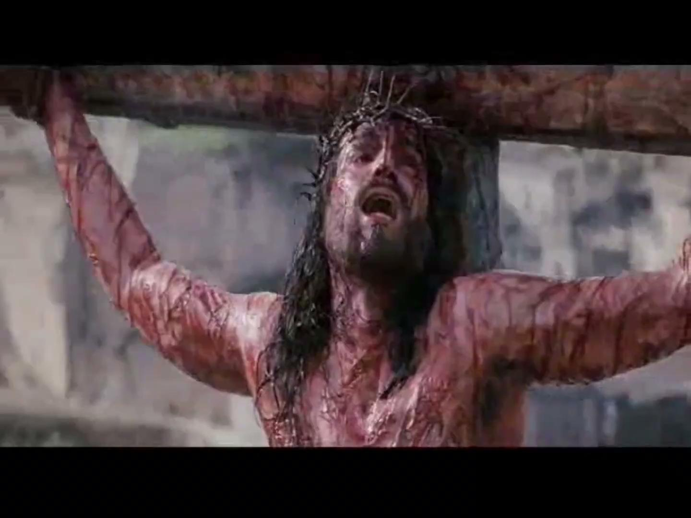

Slide 7
Caring for Your Body
1 Corinthians 10:31
3. Our Physical Health is Part of Our Witness
2 Corinthians 5:20 – "We are therefore Christ’s ______________, as though God were making his appeal through us."
ambassadors
health
serve
others
If our _______ suffers, our ability to _______ God and ________ is affected.
We glorify God when we take care of the ________ He has given us.
bodies

Slide 9
Caring for Your Body
1 Corinthians 10:31
Weekly Challenge
Reflect: How have you been treating your body?
Act: Make one change this week to honor God with your health.
Pray: Ask God to give you the strength and discipline to care for the body He has entrusted to you.

Slide 10
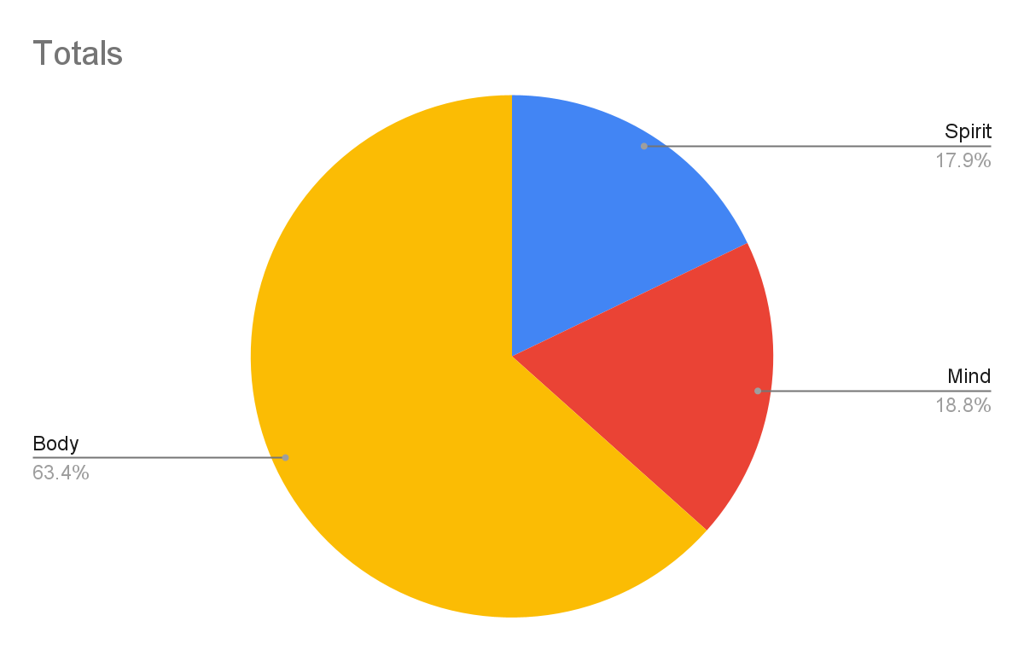
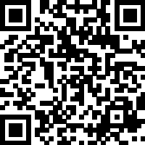
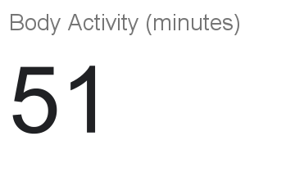
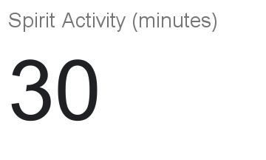
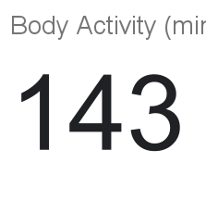
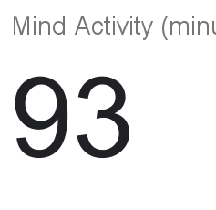
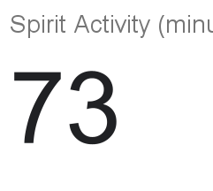
Self-Care Tracker

