Slide 3
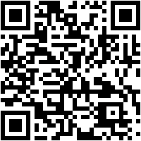
Nourishing Your Soul
Matthew 11:28-30 - "Come to me, all you who are weary and burdened, and I will give you rest. Take my yoke upon you and learn from me, for I am gentle and humble in heart, and you will find rest for your souls. For my yoke is easy and my burden is light."
Sermon Notes:
His Way Baptist Church
Keith Desso Douglas, Executive Pastor - Derrick Keith Douglas, Pastor
1818 Esther St. Houston, TX 77088

Slide 4
Nourishing Your Soul
Matthew 11:28-30
Daily Connection with God
John 15:5 – "I am the vine; you are the _________. If you remain in me and I in you, you will bear much ______; apart from me you can do _________."
branches
fruit
nothing
God
A healthy spirit comes from consistent time with ______.
prayer
worship
Spiritual self-care means prioritizing ________, _________, and time in God’s Word.

Slide 5
Nourishing Your Soul
Matthew 11:28-30
2. The Power of Solitude and Worship
Luke 5:16 – "But Jesus often _________ to lonely places and ________."
withdrew
prayed
Solitude is not loneliness; it is making space for ______.
God
problems
Worship shifts our focus from our __________ to God’s ________.
power

Slide 6
Nourishing Your Soul
Matthew 11:28-30
3. Loving Yourself as God Loves You
Mark 12:31 – "Love your __________ as yourself."
neighbor
empty
You cannot pour into others if your spirit is ________.
Seeing yourself through God’s eyes leads to _______ and ___________.
peace
confidence

Slide 7
Nourishing Your Soul
Matthew 11:28-30
Weekly Challenge
Reflect: Where have you been neglecting your spirit?
Act: Make time this week to renew your spirit through intentional prayer.
Pray: Ask God to fill you with His presence and strengthen your spiritual walk.

Slide 8
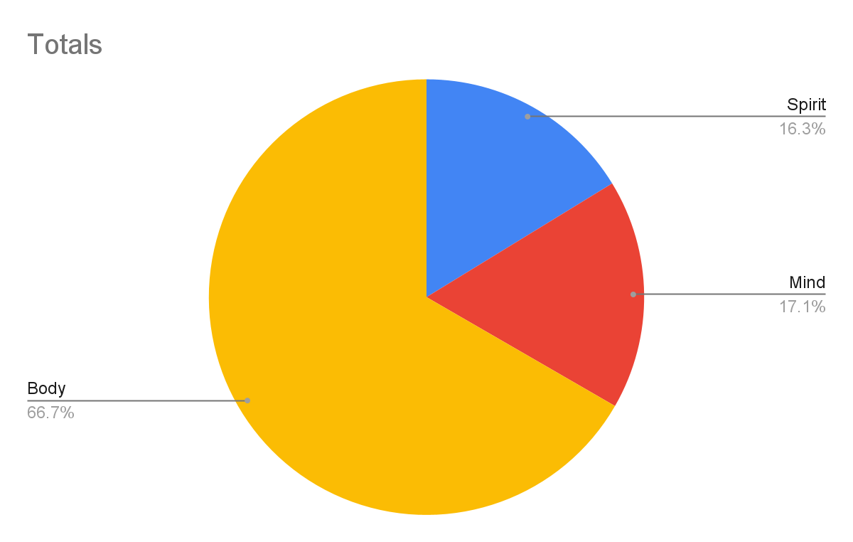
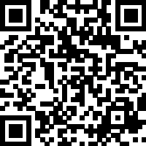
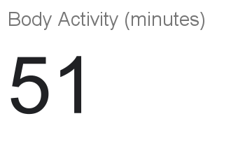
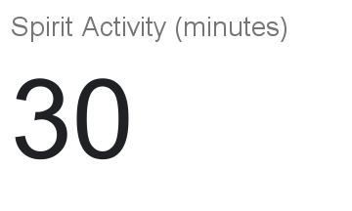
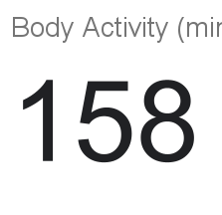
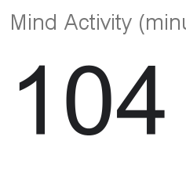
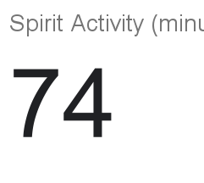
Self-Care Tracker

